Slide 1


Supervised Learning:
Naïve Baye’s
By: Sidhidatri Nayak
CDAC,NOIDA,India

Slide 2
Notice regarding the usage of images:
This document contains images obtained by routine Google
Images searches. Some of these images may perhaps be under
copyright. They are included here for educational and
noncommercial purposes and are considered to be covered by
the doctrine of Fair Use. In any event they are easily available
from Google Images.

Slide 3
Objectives
Supervised Machine Learning Algorithm
Classification techniques
What is Baye’s theorem?
Application of Bayes theorem with example.
Naïve Baye’s classifier
Approaches used by Naïve Baye’s classifier
Build and evaluate a Naive Bayes Classifier using Python's Scikit-learn package.

Slide 4
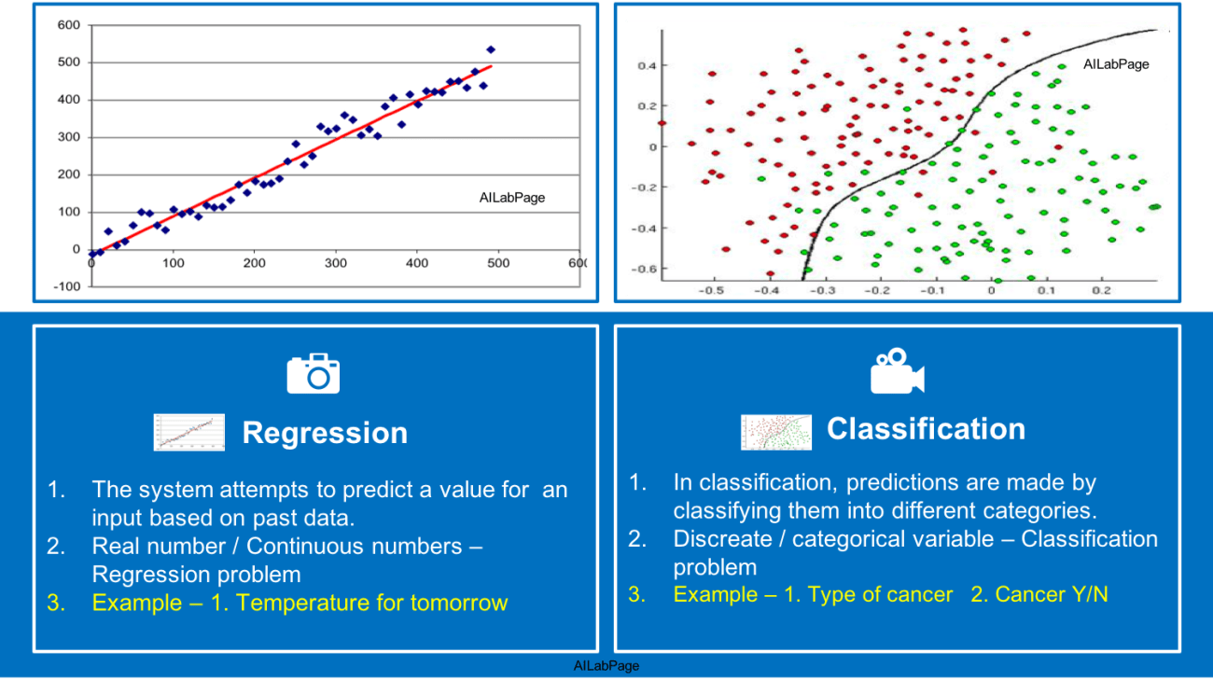
Supervised Learning
A supervised learning algorithm learns from labeled training data, helps you to predict outcomes for unforeseen data.
Works with only labeled data.
There are two techniques: Classification and Regression

Slide 5
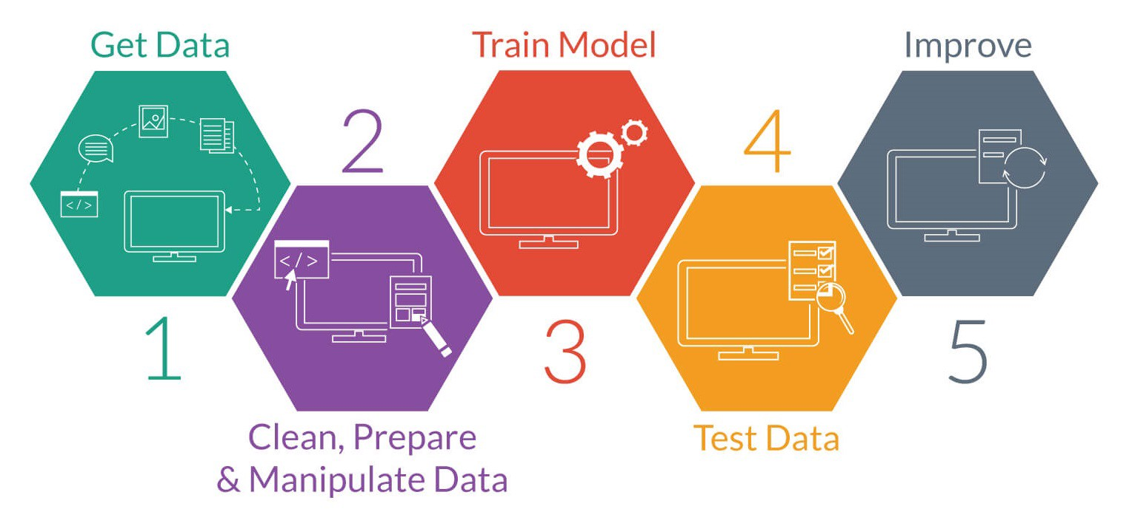
Classification

Slide 6
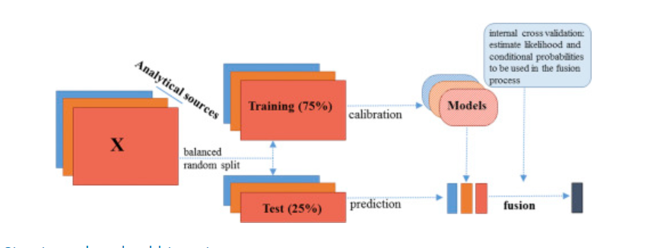
Train data and Test data

Slide 7
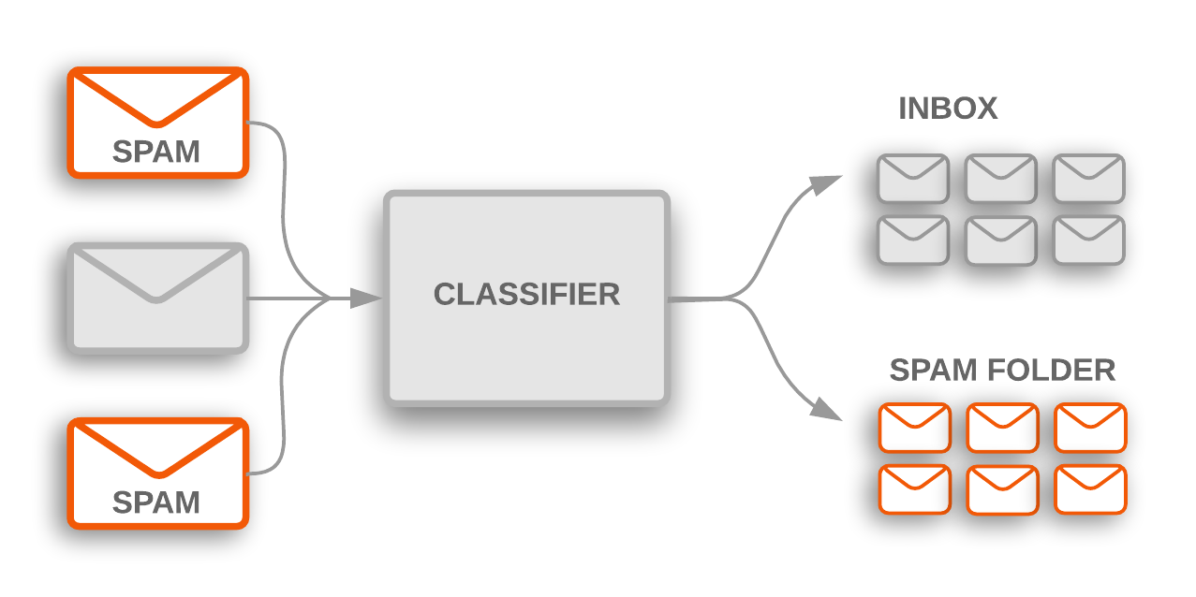
Example : spam filtering

Slide 8
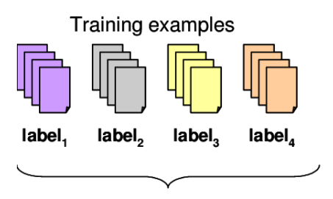
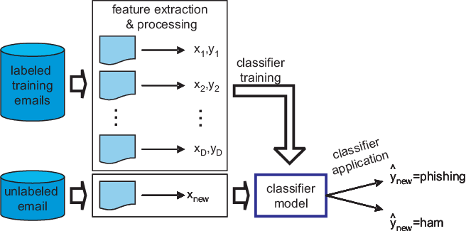
spam filtering

Slide 9
Naïve-Baye’s Algorithm

Slide 10
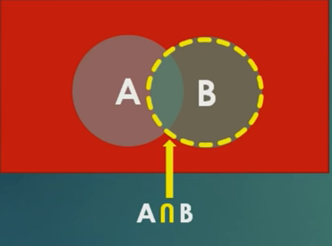
What is Baye’s theorem?
Named after Thomas Bayes
Baye’s Theorm is the formula for determining conditional probability.

Slide 11
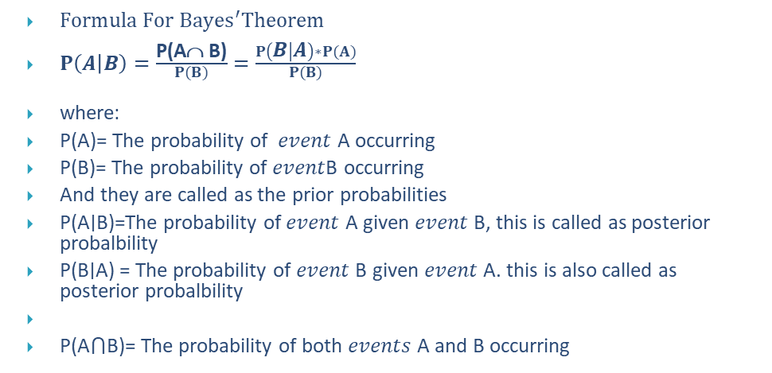
Baye’s theorem
$Formula For {Bayes}^{′}Theorem$
$P\left(A | B\right)=\frac{\text{P}\text{(}\text{A}\text{ }\text{B}\text{)}}{\begin{aligned}P(B) \\ \end{aligned}}=\frac{P\left(B | A\right)∗P(A)}{\begin{aligned}P(B) \\ \end{aligned}}$
where:
P(A)= The probability of 𝑒𝑣𝑒𝑛𝑡 A occurring
P(B)= The probability of 𝑒𝑣𝑒𝑛𝑡B occurring
And they are called as the prior probabilities
P(A∣B)=The probability of 𝑒𝑣𝑒𝑛𝑡 A given 𝑒𝑣𝑒𝑛𝑡 B, this is called as posterior probalbility
P(B∣A) = The probability of 𝑒𝑣𝑒𝑛𝑡 B given 𝑒𝑣𝑒𝑛𝑡 A. this is also called as posterior probalbility
P(A⋂B)= The probability of both 𝑒𝑣𝑒𝑛𝑡𝑠 A and B occurring

Slide 12
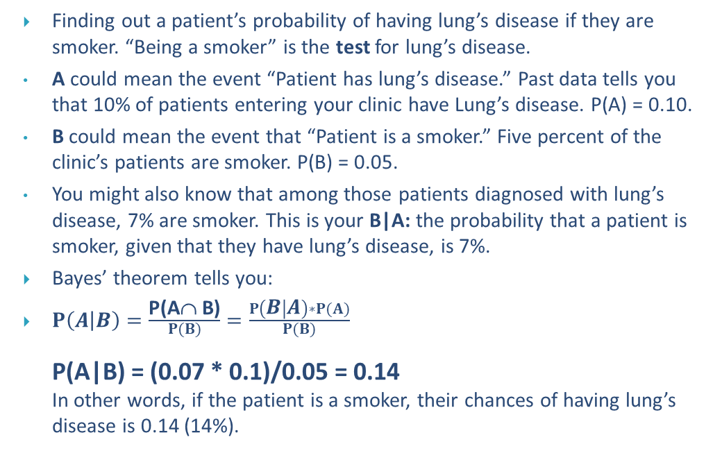
Example
Finding out a patient’s probability of having lung’s disease if they are smoker. “Being a smoker” is the test for lung’s disease.
A could mean the event “Patient has lung’s disease.” Past data tells you that 10% of patients entering your clinic have Lung’s disease. P(A) = 0.10.
B could mean the event that “Patient is a smoker.” Five percent of the clinic’s patients are smoker. P(B) = 0.05.
You might also know that among those patients diagnosed with lung’s disease, 7% are smoker. This is your B|A: the probability that a patient is smoker, given that they have lung’s disease, is 7%.
Bayes’ theorem tells you:
$P\left(A | B\right)=\frac{\text{P}\text{(}\text{A}\text{ }\text{B}\text{)}}{\begin{aligned}P(B) \\ \end{aligned}}=\frac{P\left(B | A\right)∗P(A)}{\begin{aligned}P(B) \\ \end{aligned}}$ P(A|B) = (0.07 * 0.1)/0.05 = 0.14 In other words, if the patient is a smoker, their chances of having lung’s disease is 0.14 (14%).

Slide 13
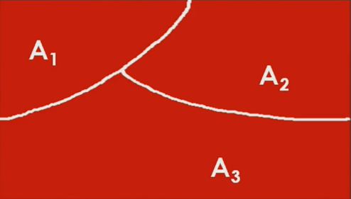
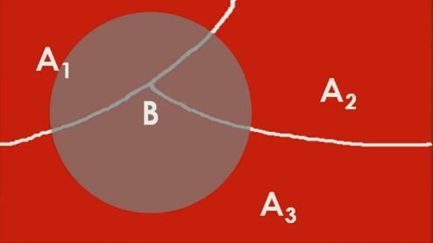
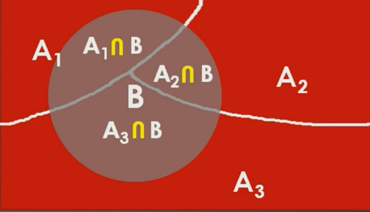
Generalized case
P(B)= P(A1∩ B)+ P(A2∩ B)+ P(A3∩ B)
P(B)= P(B|A1)* P(A1)+P(B|A2)* P(A2)+ P(B|A3)* P(A3)-------------(iii)
P(A|B)=P(B|A)* P(A) --------------(i)
P(B)
P(Ai|B)= P(B|Ai)* P(Ai) -------------- (iv)
P(B|A1)* P(A1)+P(B|A2)* P(A2)+……… P(B|An)* P(An)

Slide 14
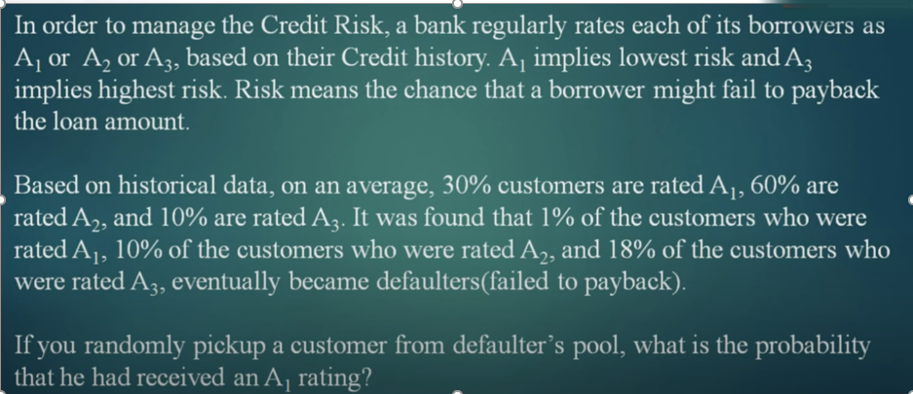
Problem

Slide 15
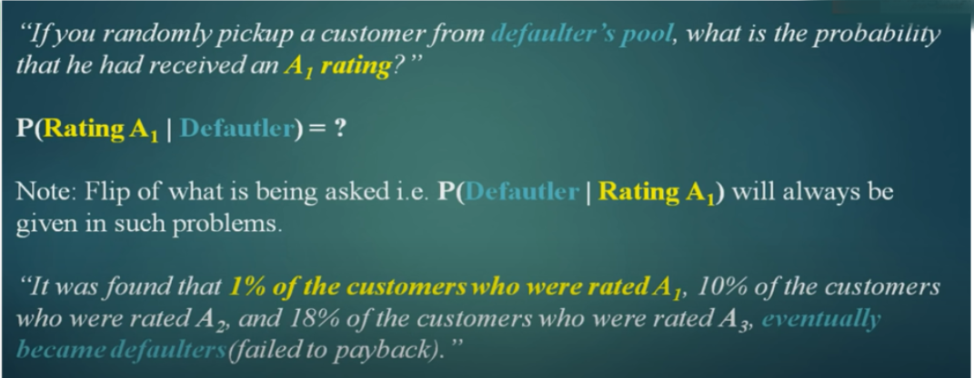
What is being asked

Slide 16
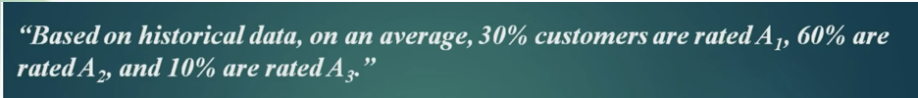

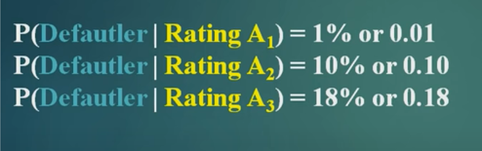
What is given

Slide 17
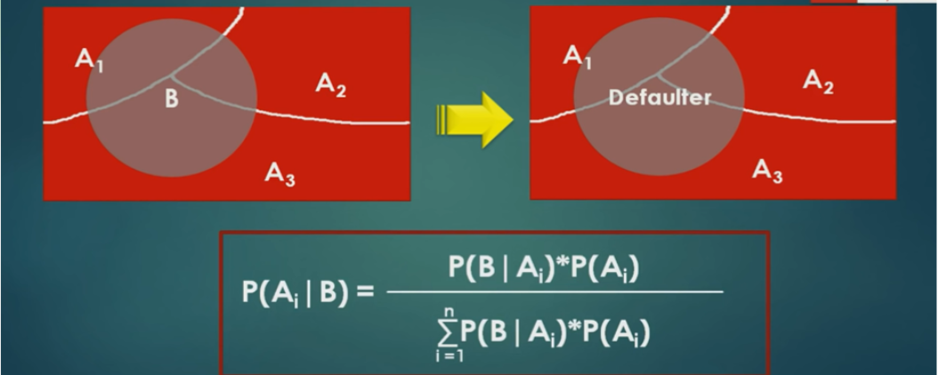

Slide 18
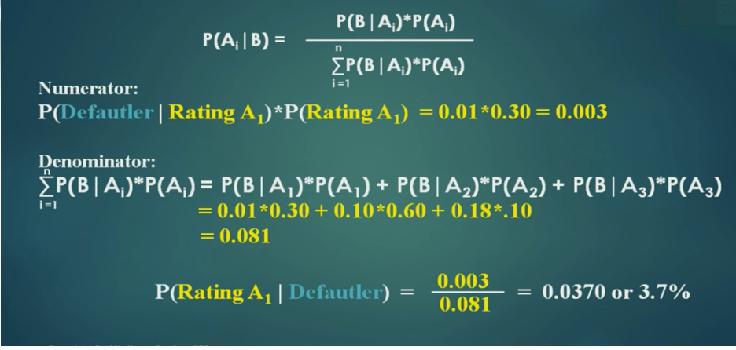
So, there is 3.7 probability that he is has A1 rating.

Slide 19
What is Naive Bayes Classifier?
Naive Bayes is a statistical classification technique based on Bayes Theorem.
Naive Bayes classifier assumes that the effect of a particular feature in a class is independent of other features.
For example, a loan applicant is desirable or not depending on his/her income, previous loan and transaction history, age, and location.
Even if these features are interdependent, these features are still considered independently.
This assumption simplifies computation, and that's why it is considered as naive. This assumption is called class conditional independence.

Slide 20
Advantages of Naïve Baye’s Classification
Simplest supervised learning algorithms.
Naive Bayes classifier is the fast, accurate and reliable algorithm.
Naive Bayes classifiers have high accuracy and speed on large datasets.
Applications:
Text classification
Spam filtration
Sentiment Analysis
Recommendation System

Slide 21
How Naive Bayes classifier works?
Single feature (only A is given to predict the occurrence of B)
Multiple feature (A1, A2, A3…… Ai is given to predict the occurrence of B )

Slide 22
First Approach (In case of a single feature)
Step 1: Calculate the prior probability for given class labels
Step 2: Find Likelihood probability with each attribute for each class
Step 3: Put these value in Bayes Formula and calculate posterior probability.
Step 4: See which class has a higher probability, given the input belongs to the higher probability class.

Slide 23
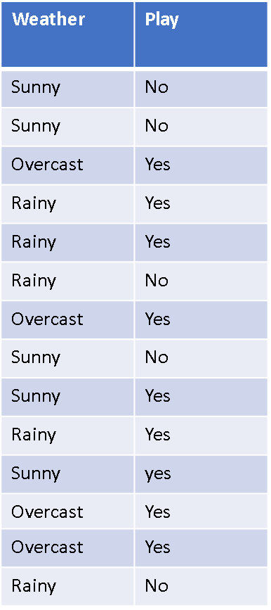
Question
Suppose you want to calculate the probability of playing when the weather is Sunny.

Slide 24
Example
Frequency Table
Weather | Play
Sunny | No
Sunny | No
Overcast | Yes
Rainy | Yes
Rainy | Yes
Rainy | No
Overcast | Yes
Sunny | No
Sunny | Yes
Rainy | Yes
Sunny | yes
Overcast | Yes
Overcast | Yes
Rainy | No
Weather | No | Yes
Overcast | 0 | 4
Sunny | 2 | 3
Rainy | 3 | 2
Total | 5 | 9
Likelihood Table 1
Likelihood Table 2
Weather | No | Yes
Overcast | 0 | 4 | =4/14 | 0.29
Sunny | 2 | 3 | =5/14 | 0.36
Rainy | 3 | 2 | =5/14 | 0.36
Total | 5 | 9
 | =5/14 | =9/14
 | 0.36 | 0.64
Weather | No | Yes | Posterior probability for NO | Posterior probability for YES
Overcast | 0 | 4 | 0/5=0 | 4/9=4.4
Sunny | 2 | 3 | 2/5=0.4 | 3/9=0.33
Rainy | 3 | 2 | 3/5=0.6 | 2/9=0.22
Total | 5 | 9

Slide 25
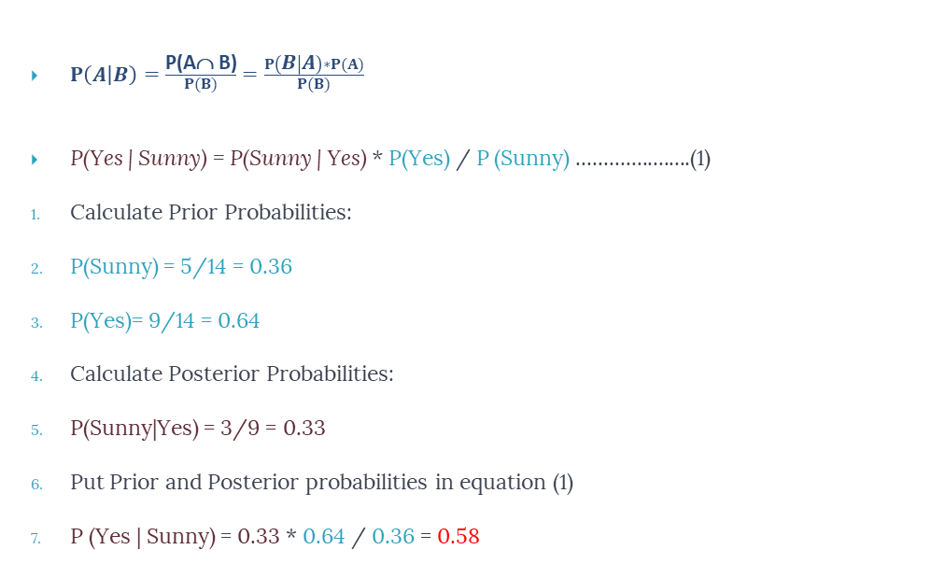
Probability of playing (yes):
$P\left(A | B\right)=\frac{\text{P}\text{(}\text{A}\text{ }\text{B}\text{)}}{\begin{aligned}P(B) \\ \end{aligned}}=\frac{P\left(B | A\right)∗P(A)}{\begin{aligned}P(B) \\ \end{aligned}}$
P(Yes | Sunny) = P(Sunny | Yes) * P(Yes) / P (Sunny) .....................(1)
Calculate Prior Probabilities:
P(Sunny) = 5/14 = 0.36
P(Yes)= 9/14 = 0.64
Calculate Posterior Probabilities:
P(Sunny|Yes) = 3/9 = 0.33
Put Prior and Posterior probabilities in equation (1)
P (Yes | Sunny) = 0.33 * 0.64 / 0.36 = 0.58

Slide 26
Probability of Not playing (No):
P(No| Sunny) = P(Sunny | No) * P(No) / P (Sunny) .....................(1)
Calculate Prior Probabilities:
P(Sunny) = 5/14 = 0.36
P(No)= 5/14 = 0.36
Calculate Posterior Probabilities:
P(Sunny|No) = 2/5 = 0.4
Put Prior and Posterior probabilities in equation (1)
P (No | Sunny) = 0.4 * 0.36 / 0.36 = 0. 4

Slide 27
Result:
The probability of the 'Yes' class is higher.
So you can determine here if the weather is Sunny then players will play the sport.

Slide 28
More than one feature

Slide 29
Question
Suppose you want to calculate the probability of playing when the weather is sunny, and the temperature is mild.

Slide 30
Second Approach (In case of multiple features)
Step 1:Calculate prior probability for given class labels.
Step 2: Calculate Conditional Probability with each attribute for each class.
Step 3: Multiply same class conditional probability.
Step 4: Multiply prior probability with step-3 probability.
Step 5: See which class has higher probability.

Slide 31
Bayesian classification
The classification problem may be formalized using a-posteriori probabilities:
P(C|X) = prob. that the sample tuple X=<x₁,…,x_{k}> is of class C.
E.g. P(class=Yes | Weather=sunny, temperature=mild,windy=true,…)

Slide 32
Play-cricket example: classifying X
An unseen sample X = <rainy, hot, high, false> , Class C=<Yes,No>
P(class=yes|weather=rainy,temperature=hot,humidity=high, windy=false)= P(X|yes)*P(yes)
P(X|yes)*P(yes) = (P(rainy|yes)*P(hot|yes)*P(high|yes)*P(false|yes))*P(yes)
P(class=no|weather=rainy.temperature=hot,humidity=high, windy=false)= P(X|no)*P(no)
P(X|no)*P(no)=
(P(rainy|no)*P(hot|no)*P(high|no)*P(false|no))*P(no)

Slide 33
Question
Suppose you want to calculate the probability of playing when the weather is overcast, and the temperature is mild.

Slide 34
Example
Frequency Table
Weather | Temp | Play
Sunny | Hot | No
Sunny | Hot | No
Overcast | Hot | Yes
Rainy | Mild | Yes
Rainy | Cool | Yes
Rainy | Cool | No
Overcast | Cool | Yes
Sunny | Mild | No
Sunny | Cool | Yes
Rainy | Mild | Yes
Sunny | Mild | yes
Overcast | Mild | Yes
Overcast | Hot | Yes
Rainy | Mild | No
Weather | No | Yes
Overcast | 0 | 4
Sunny | 2 | 3
Rainy | 3 | 2
Total | 5 | 9
Likelihood Table 1
Likelihood Table 2
Weather | No | Yes
Overcast | 0 | 4 | =4/14 | 0.29
Sunny | 2 | 3 | =5/14 | 0.36
Rainy | 3 | 2 | =5/14 | 0.36
Total | 5 | 9
 | =5/14 | =9/14
 | 0.36 | 0.64
Weather | No | Yes | Posterior probability for NO | Posterior probability for YES
Overcast | 0 | 4 | 0/5=0 | 4/9=4.4
Sunny | 2 | 3 | 2/5=0.4 | 3/9=0.33
Rainy | 3 | 2 | 3/5=0.6 | 2/9=0.22
Total | 5 | 9

Slide 35
Example
Frequency Table
Weather | Temperature | Play
Sunny | Hot | No
Sunny | Hot | No
Overcast | Hot | Yes
Rainy | Mild | Yes
Rainy | Cool | Yes
Rainy | Cool | No
Overcast | Cool | Yes
Sunny | Mild | No
Sunny | Cool | Yes
Rainy | Mild | Yes
Sunny | Mild | yes
Overcast | Mild | Yes
Overcast | Hot | Yes
Rainy | Mild | No
Temperature | No | Yes
Hot | 2 | 2
Mild | 2 | 4
Cool | 1 | 3
Total | 5 | 9
Likelihood Table 1
Likelihood Table 2
Temperature | No | Yes
Hot | 2 | 2 | =4/14 | 0.28
Mild | 2 | 4 | =5/14 | 0.36
Cool | 1 | 3 | =4/14 | 0.28
Total | 4 | 9
 | =5/14 | =9/14
 | 0.36 | 0.64
Temperature | No | Yes | Posterior probability for NO | Posterior probability for YES
Hot | 2 | 2 | 2/5=0.4 | 2/9=0.22
Mild | 2 | 4 | 2/5=0.2 | 4/9=0.44
Cool | 1 | 3 | 1/5=0.2 | 3/9=0.33
Total | 5 | 9

Slide 36
Probability of Playing
P(yes|Sunny,mild)=P(Sunny, mild|yes)*p(yes) …………..(1)
P(Sunny, mild|yes)=P(Sunny |Yes) *P(Mild |Yes) ……………(2)
Calculate Prior Probabilities: P(Yes)= 9/14 = 0.64
Calculate Posterior Probabilities: P(Sunny|Yes) = 3/9 = 0.33
P(Mild |Yes) = 4/9 = 0.44
3. Put Posterior probabilities in equation (2)
P(Sunny,Mild |Yes) = 0.33 * 0.44 = 0.1452
4. Put Prior and Posterior probabilities in equation (1)
P(Yes | Sunny, Mild) = 0.1452*0.64 = 0.092

Slide 37
Probability of Not Playing
P(no|Sunny,mild)=P(Sunny, mild|no)* p(no)………………..(1)
P(Sunny, mild|no)=P(Sunny |no) * P(Mild |no) ………..(2)
Calculate Prior Probabilities: P(no)= 5/14 = 0.36
Calculate Posterior Probabilities: P(Sunny|no) = 2/5 = 0.4
P(Mild |no) = 4/9 = 0.44
3. Put Posterior probabilities in equation (2)
P(Sunny,Mild |no) = 0.4 * 0.44 = 0.176
4. Put Prior and Posterior probabilities in equation (1)
P(no| Sunny, Mild) = 0.176*0.36 = 0.06

Slide 38
Result:
The probability of a 'Yes' class is higher. So you can say here that if the weather is overcast than players will play the sport.

Slide 39
Naive Bayes Classifier Building in Scikit-learn
# Assigning features and label variables
The first two are features(weather, temperature) and the other is the label.
weather=['Sunny','Sunny','Overcast','Rainy','Rainy','Rainy','Overcast','Sunny','Sunny',
'Rainy','Sunny','Overcast','Overcast','Rainy']
temp=['Hot','Hot','Hot','Mild','Cool','Cool','Cool','Mild','Cool','Mild','Mild','Mild','Hot','Mild']
play=['No','No','Yes','Yes','Yes','No','Yes','No','Yes','Yes','Yes','Yes','Yes','No']

Slide 40
Label Encoder
# Import LabelEncoder from sklearn
import preprocessing
#creating labelEncoder
le = preprocessing.LabelEncoder()
# Converting string labels into numbers. weather_encoded=le.fit_transform(weather) print weather_encoded
First, you need to convert these string labels into numbers.
for example: 'Overcast', 'Rainy', 'Sunny' as 0, 1, 2. This is known as label encoding.
Scikit-learn provides LabelEncoder library for encoding labels with a value between 0 and one less than the number of discrete classes
[2 2 0 1 1 1 0 2 2 1 2 0 0 1]
weather=['Sunny','Sunny','Overcast','Rainy','Rainy','Rainy','Overcast','Sunny','Sunny',
'Rainy','Sunny','Overcast','Overcast','Rainy']

Slide 41
Label Encoder
# Converting string labels into numbers
temp_encoded=le.fit_transform(temp)
label=le.fit_transform(play)
print "Temp:",temp_encoded
print "Play:",label
Temp: [1 1 1 2 0 0 0 2 0 2 2 2 1 2]
temp=['Hot','Hot','Hot','Mild','Cool','Cool','Cool','Mild','Cool','Mild','Mild','Mild','Hot','Mild']
Play: [0 0 1 1 1 0 1 0 1 1 1 1 1 0]
play=['No','No','Yes','Yes','Yes','No','Yes','No','Yes','Yes','Yes','Yes','Yes','No']
#Combinig weather and temp into single listof tuples
features=zip(weather_encoded,temp_encoded)
print features
[(2, 1), (2, 1), (0, 1), (1, 2), (1, 0), (1, 0), (0, 0), (2, 2), (2, 0), (1, 2), (2, 2), (0, 2), (0, 1), (1, 2)]

Slide 42
Model Generation
Generate a model using naive bayes classifier in the following steps:
Create naive bayes classifier
Fit the dataset on classifier
Perform prediction

Slide 43
#Import Gaussian Naive Bayes model
from sklearn.naive_bayes import GaussianNB
#Create a Gaussian Classifier
model = GaussianNB()
# Train the model using the training sets
model.fit(features,label)
#Predict Output
predicted= model.predict([[0,2]]) # 0:Overcast, 2:Mild
print "Predicted Value:", predicted
Predicted Value: [1]
Here, 1 indicates that players can 'play'.

Slide 44
Python Implementation

Slide 45
Thank You

